Slide 1
Natural Language Processing
on GitHub Issue Comments
Jamie Whitacre

Slide 2
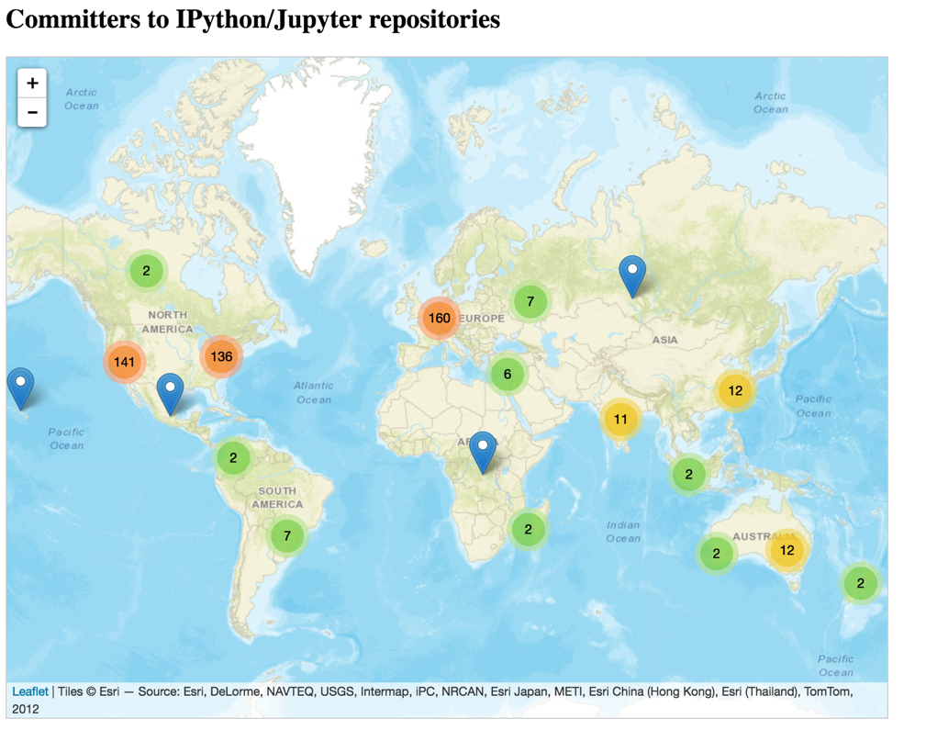

Slide 3


Problem Summary
We maintain our code base and issue logs in ~5 GitHub organizations with multiple repositories in each org
GitHub issue logs can be somewhat unwieldy to manage across repositories and organizations and require manual tagging, sorting, filtering, and general organizing.
jupyter
jupyterlab
jupyterhub
jupyter-widgets
ipython

Slide 4
Research Question
Can topic modeling/LDA be used get a sense of what’s in our issue logs and (eventually) enable an approach for resolving issues, identifying feature requests, and prioritizing work?
Criteria for success: Clear groupings of feature and issues types / themes

Slide 5
Problem Summary
We maintain our code and issue logs in ~5 GitHub organizations with multiple repositories
GitHub issue logs can be somewhat unwieldy to manage across repositories and organizations and require manual tagging, sorting, filtering, and general organizing.
jupyter
jupyterlab
jupyterhub
jupyter-widgets
ipython

Slide 6

github.com/jupyter

Slide 7
Acquire the data
Used the GetOrg package to access the GitHub API v3 and download the issue comment threads.
GitHub has great documentation for their API here: https://developer.github.com/v3/

Slide 8
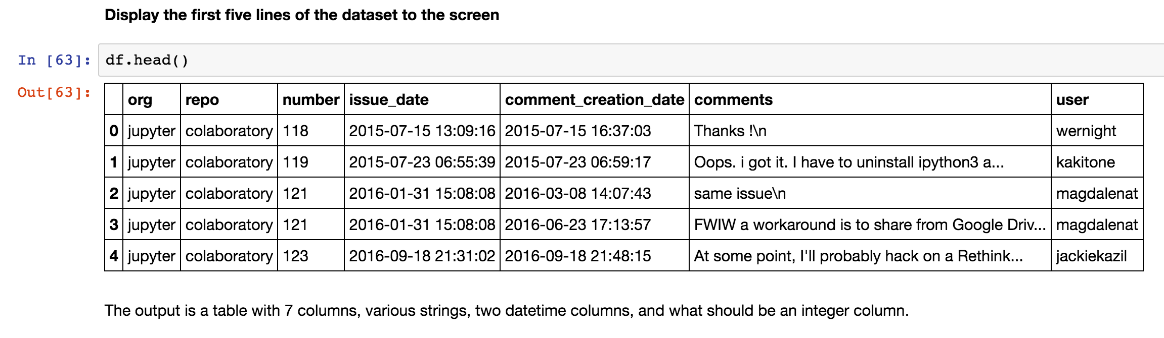
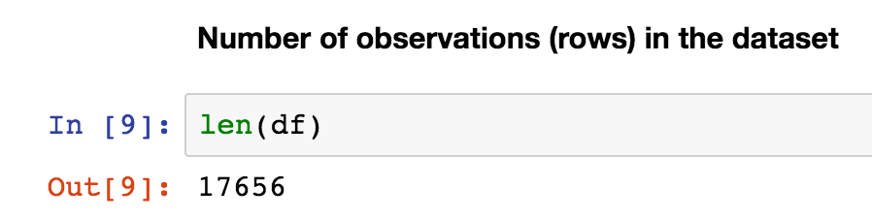
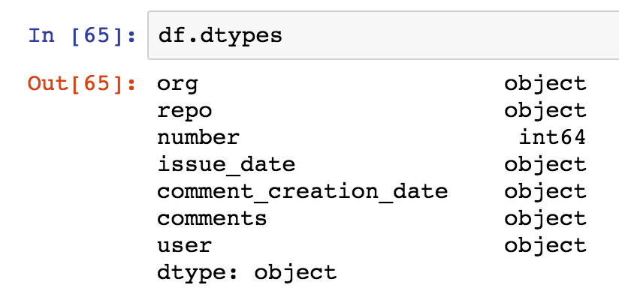
Exploratory Data Analysis
Data Types
Number of features after stop words removed: 9,156
Too many!

Slide 9
Build a data model
Selected the gensim LDA model to create a topic model

Slide 10
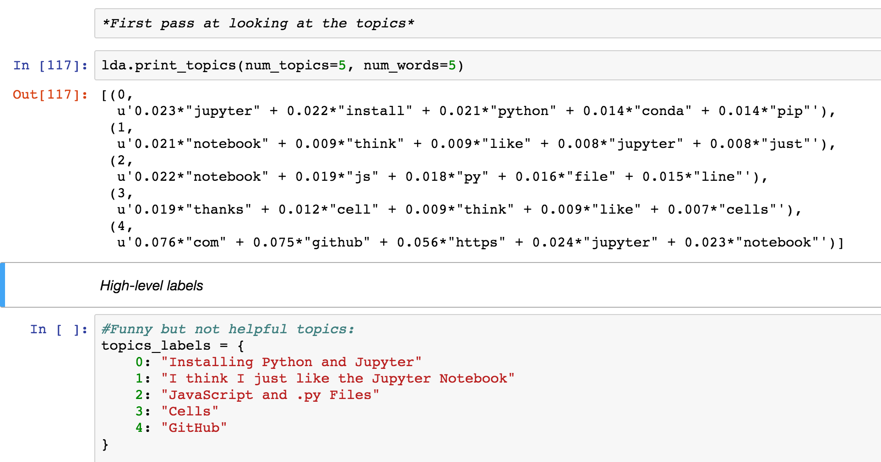
Evaluate and refine model

Slide 11
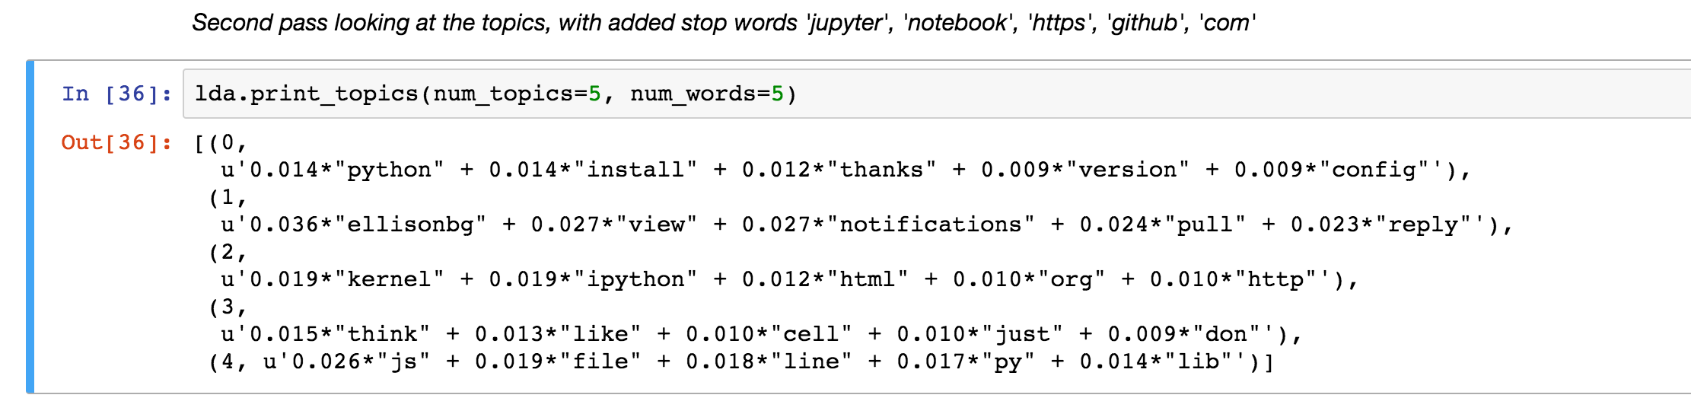
Evaluate and refine model - add more stop words

Slide 12
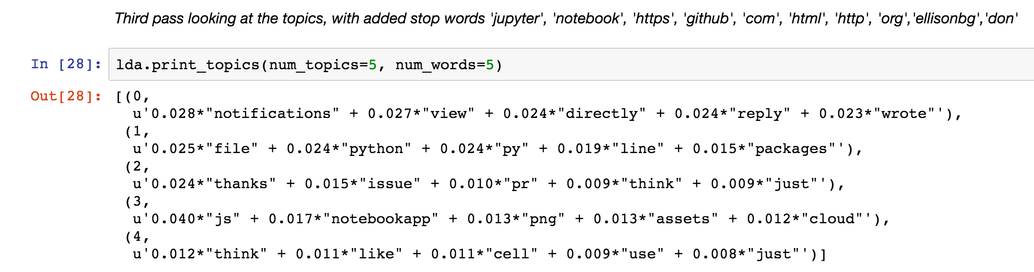
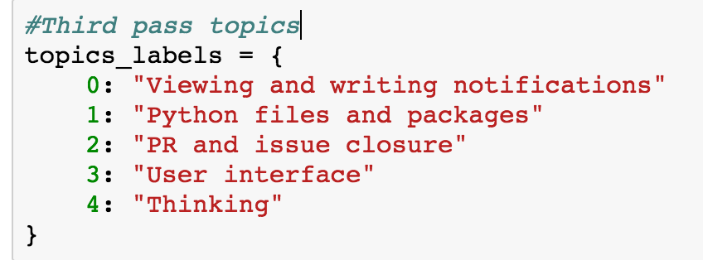
Evaluate and refine model - add more stop words

Slide 13
Results
Success criteria: Clear groupings of feature and issues types / themes
Criteria met?
Not yet!

Slide 14
Next steps
- Additional data cleaning may help repress noise
- Try K-Means clustering to quantitatively determine ideal number of topics
- Perform topic modeling on each repo instead of entire set
- Incorporate a sentiment analysis to measure the vibe of different orgs and repos and identify areas of the project to increase community satisfaction
- Time series analysis could be fun
Follow-up problems and questions for future analysis
Limitations of the data
GitHub issues is just one place where we communicate with users. Gitter, mailing lists, twitter, conferences, and tutorials are all places where we interact with users and receive feedback
Ideal data vs. data that was available
This study would be strongest if it spanned across all development orgs. The current data set only covers the main Jupyter org due to reaching my API rate limit with GitHub.

Slide 15
Thanks!

